Slide 1
SQL Server Automation with PowerShell, dbatools and GitHub Actions
Jess Pomfret
(She/Her)
Data Platform Engineer
Organization/business

Slide 2



Jess
Pomfret
She/Her
Data Platform Engineer
Open-Source Contributor
dbatools, dbachecks
Passionate about
Automation
Proper Football
Fitness
Microsoft MVP
Data Platform
Microsoft Azure
Data Masterminds
@jpomfret.co.uk
jpomfret
JessPomfret.com
Notes:
Peter

Slide 3
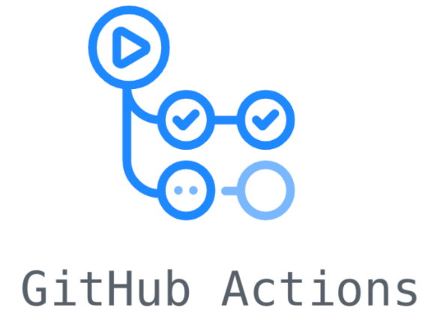



What’s the Plan?
What are GitHub Actions?
Add in some PowerShell & dbatools
Automate some administration tasks

Slide 4

GitHub Actions

Slide 5
GitHub Actions
CI\CD Platform
Allows you to automate things
Based on triggers
Schedule
Commit
Pull Request
Issue
Uses GitHub Hosted or Self-Hosted runners
Notes:
Who’s already using GitHub Actions?

Slide 6

Azure DevOps Pipelines
CI\CD Platform
Allows you to automate things
Based on triggers
Schedule
Commit
Pull Request
Work Item (not as easy – need to use webhook trigger)
Uses Microsoft Hosted or Self-Hosted agents

Slide 7
GitHub Actions use cases
On push – run automated tests
On schedule – look for issues that are stale
Manually – publish package to NuGet
On issue creation
Create a SQL Server database?
add article to replication?
Start an agent job?

Slide 8
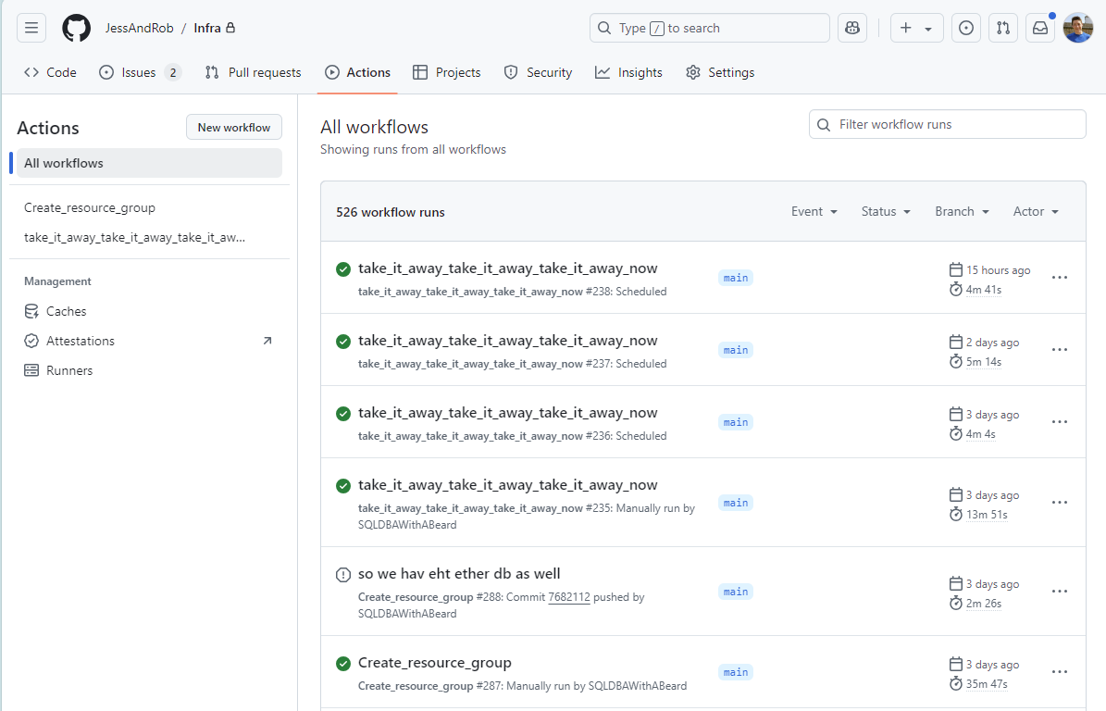
Notes:
Point out schedule runs
Manually triggered runs
One that was cancelled

Slide 9
Demo Time – Our first GitHub Action!
Mark stale issues and pull requests
AI Summaries?

Slide 10
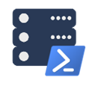
dbatools

Slide 11
It’s like a command line SQL Server Management Studio If you can do it in SSMS – you can do it in dbatools* *mostly

Slide 12
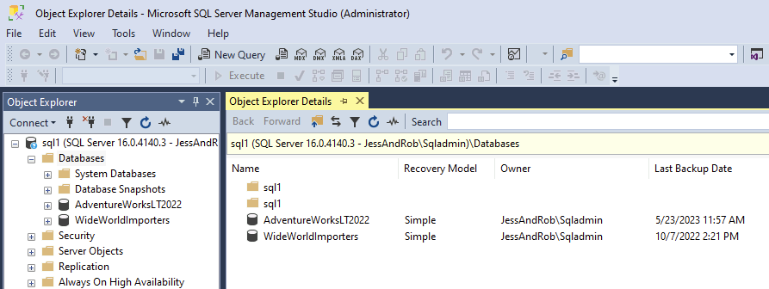
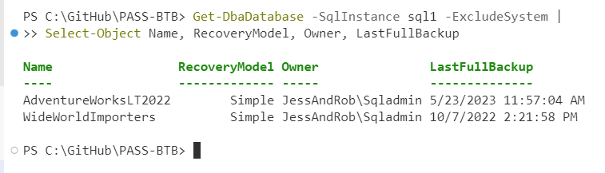
Get Database Info for User Database on Sql1

Slide 13
Get Database Info for User Database on Sql1

Slide 14
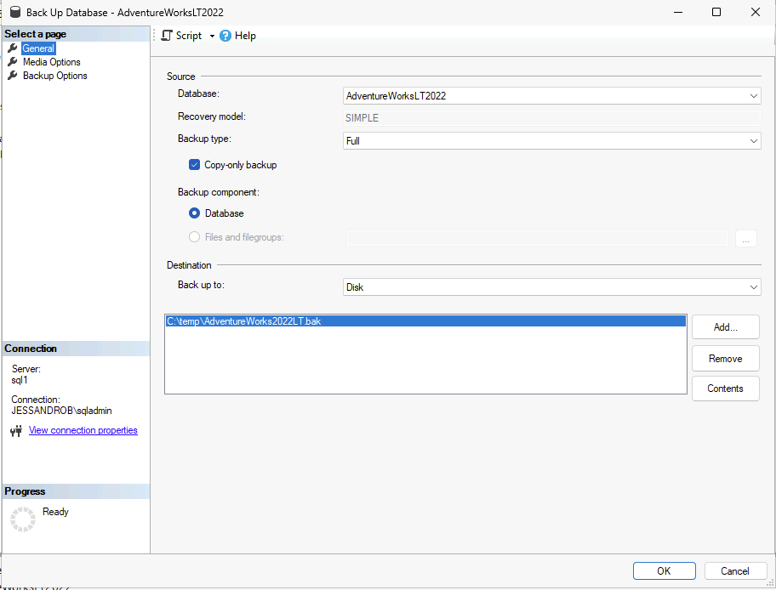
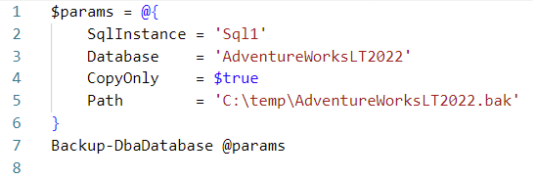
Backup a database on Sql1
Notes:
Right click database > tasks > backup

Slide 15
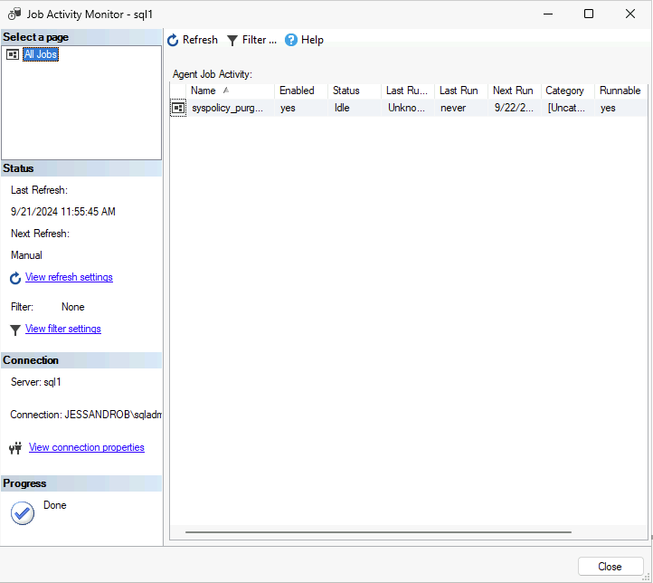
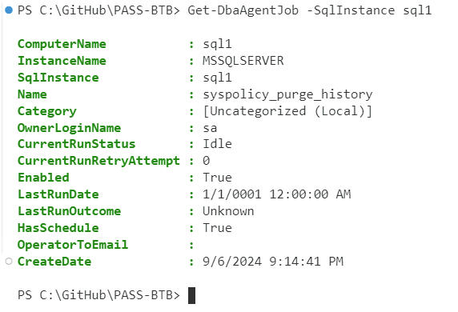
Get SQL Agent jobs on Sql1

Slide 16
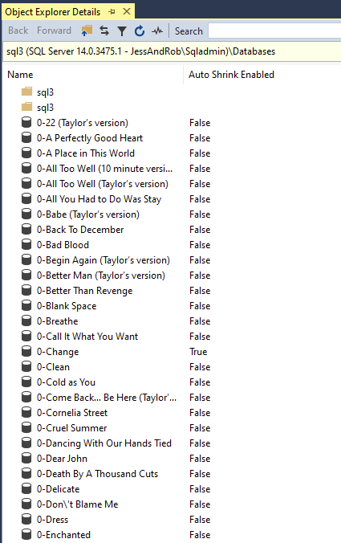
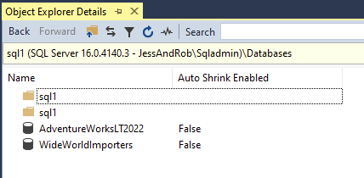
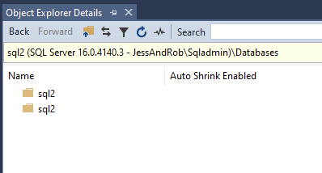
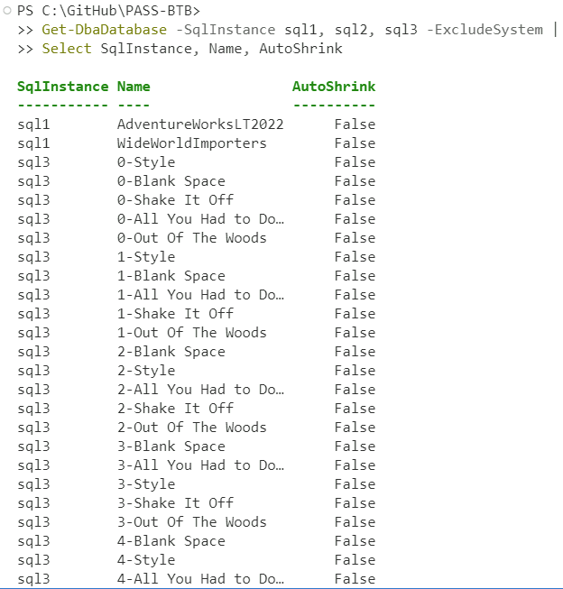
Get Database Name and AutoShrink status on Sql1, Sql2 and Sql3

Slide 17
Get Database Name and AutoShrink status on Sql1, Sql2 and Sql3

Slide 18
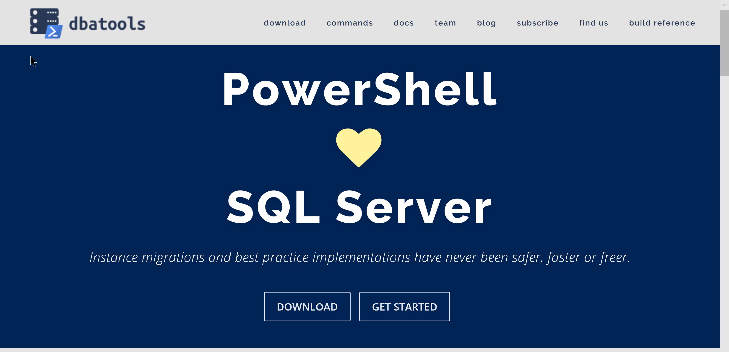
dbatools.io

Slide 19
Demo Time – dbatools Magic
Create a new database
Backup some databases
Collect some information

Slide 20
GitHub Actions & dbatools

Slide 21
GitHub Actions - Runners
Where the code runs
GitHub-hosted runners
Self-hosted runners
https://docs.github.com/en/actions/concepts/runners
Notes:
GitHub Hosted
GitHub Actions usage is free for standard GitHub-hosted runners in public repositories
Series of types you can choose – windows, linux, different versions
Self-hosted
More control
Free to use
Inside your network so access to things
Note – if you swap your repo to be public you need to change a setting that allows your self-hosted runner to run – otherwise it sits there waiting for jobs, and your actions sit there waiting for runners

Slide 22
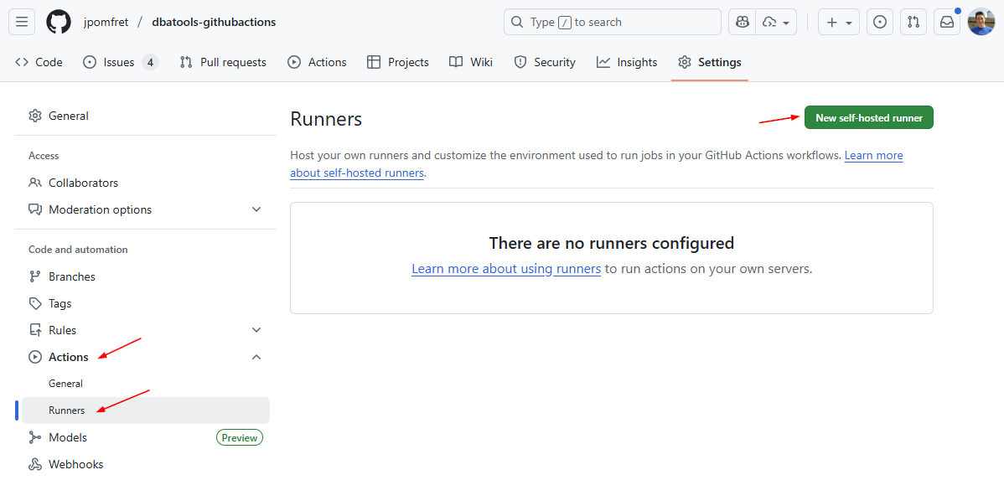
Install a Self-Hosted Runner

Slide 23
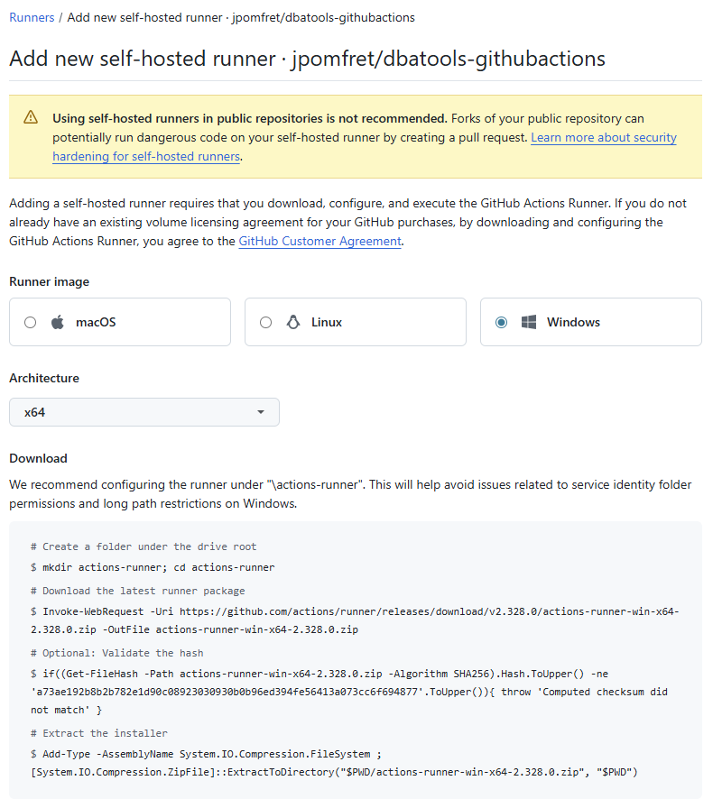

Slide 24
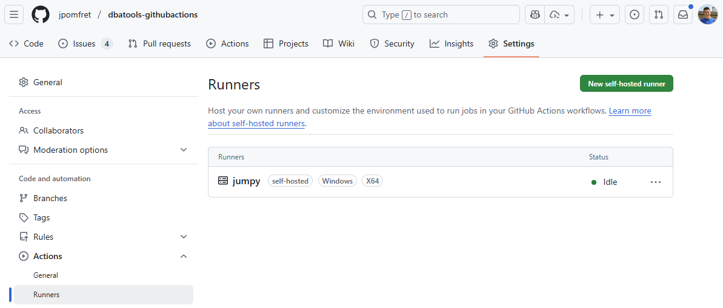

Slide 25
Demo Time – extra magic
On issue creation
Create a new database
Add article to replication
On commit
Deploy database code

Slide 26


Slide 27

Jess Pomfret
@jpomfret.co.uk
jpomfret
JessPomfret.com

